Slide 1
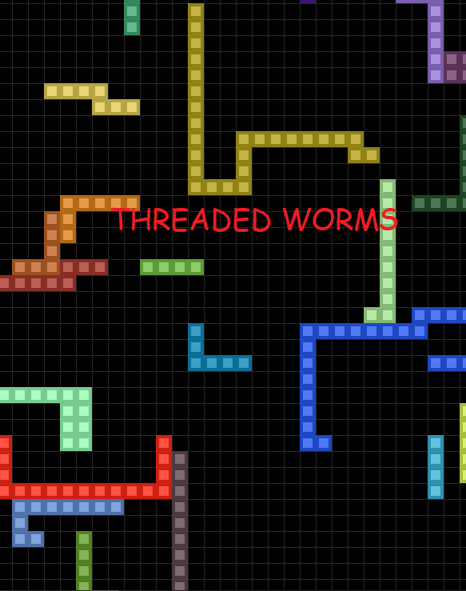
Multithreading Shared Variable, and Mutex Locks Simulation
ZainShahzad 20B-028-CS
AlizaAzam 20B-112-CS

Slide 2

Purpose
To combine topics related to concurrent or parallel computing
Try to visualize multi-threading in python within the constraints of python GIL
The program demonstrates multithreaded programming and using locks to make the code thread-safe (worms will never go through each other.)

Slide 3
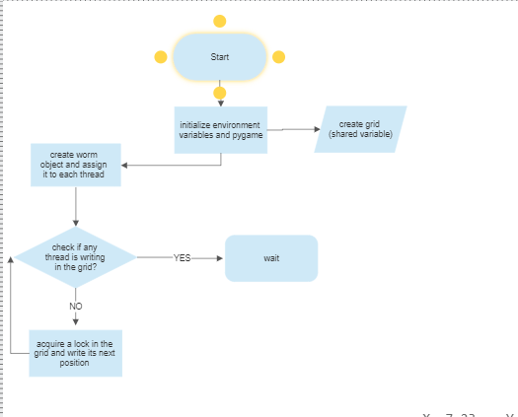
Flow:

Slide 4
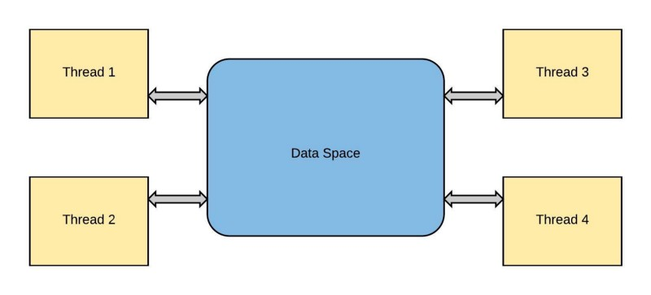
Threading
Within a program, a thread is a separate execution path. It is a lightweight process that the operating system can schedule and run concurrently with other threads. The operating system creates and manages threads, and they share the same memory and resources as the program that created them. This enables multiple threads to collaborate and work efficiently within a single program.

Slide 5
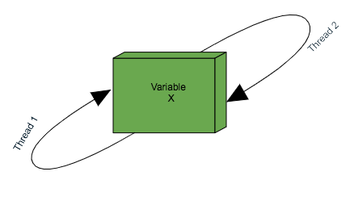
Shared Grid Data Structure and Locking
Each thread acquires a lock within the grid and writes certain co-ordinates onto it (its next position) and the lock is then released. The next thread will first read the data within the grid and check if the position it wants to write on is occupied or free? If its not free (occupied location + 1) all of this will be happening after locking the grid to avoid race conditions and make sure our program is thread safe

Slide 6
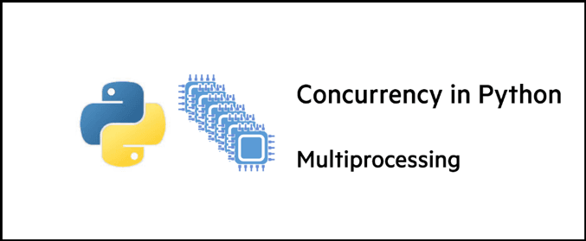
Not Truly Parallel
Due to the limitation of the Cython compiler the threads created in python aren’t fully running in concurrency, python’s Global Interpreter Lock disallows threads to truly run in parallel on a CPU. However, we can achieve some degree of parallelism by having multiple threads one for logic other for I/O.

Slide 7
Not Truly Parallel
Each worm thread has two behaviors,
1 Calculate logic of next position
2 Do an IO request fetch and store data to memory
We achieve parallelism when thread 2 is making an IO request to store some data or read the data from the grid data structure, simultaneously thread 1 will be calculating the next logic for where to move next within the grid. The crux is that whenever there’s an IO request from a thread we utilize threading and move the IO to a different thread and occupy the CPU with the next thread that needs to calculate logic of movement.

Slide 8

Demonstration

